Slide 1

AI TOOL:
OLLAMA
There are a lot of interpretations of what Ollama is, like: It’s a library, a framework, an open-source lightweight platform, it’s quite docker-like, an LLM server, an LLM puller app, etc.
But to simplify, Ollama is: “The runner and container of Open Large Language Models, locally and without the need of internet through the CLI”.
PAGE 01

Slide 2
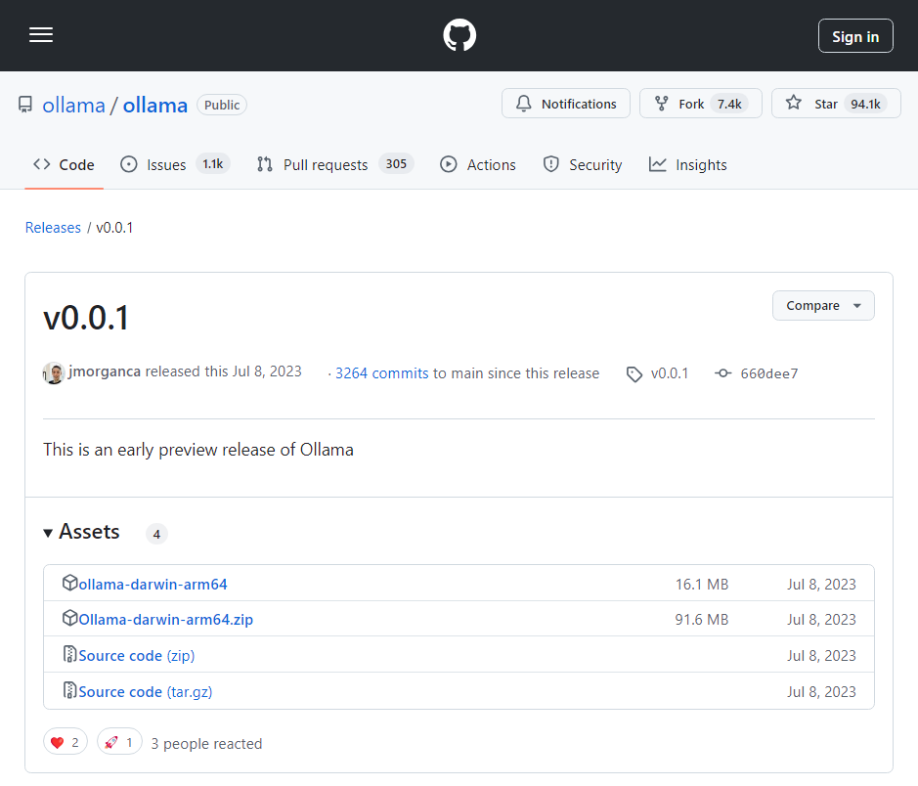
BACKGROUND
PAGE 02
Stands for Omni-Layer Learning Language Acquisition Model.
BACKGROUND
Ollama was released for the first in 2023 by Michael Chiang and Jeffrey Morgan in Palo Alto, CA.
It is based on llama.cpp (an implementation of the Llama architecture in plan C/C++).
They published the first revision (v0.0.1) on Github, and began by supporting the 1st LLM: Llama2.

Slide 3
BACKGROUND
PRICING?
PAGE 03

Slide 4



BACKGROUND
PRICING?
PAGE 03

Slide 5






REQUIREMENTS, COMPATIBILITY INTEGRATIONS
SUPPORTED OPERATING SYSTEMS
INTEGRATIONS & LIBRARIES
INTERFACES
HARDWARE REQUIREMENTS
Open-webUI
Chatbot-ollama
RAM: At least 8GB available
GPU: Nvidia GPUs with compute capability 5.0+ and some AMD Radeon cards.
PAGE 04

Slide 6
CHARACTERISTICS
CHARACTERISTICS
LOCAL EXECUTION & OFFLINE ACCESS
EXTENSIVE PRE-TRAINED MODEL LIBRARY
PRIVACY
SEAMLESS INTEGRATION
MULTI-MODAL INPUTS
CUSTOMIZATION (CREATE OUR OWN MODELS AND APPLY USER FRIENDLY-INTERFACES)
PASSING AN ARGUMENT WITHIN A PROMPT
SERVING AS A REST API
PAGE 05

Slide 7

FUNCTIONALITY
DIGGIN’ DIP INTO IT
How is it possible that Ollama can run LLMs without internet?, How does it work?, Is my data compromised?
PAGE 06

Slide 8
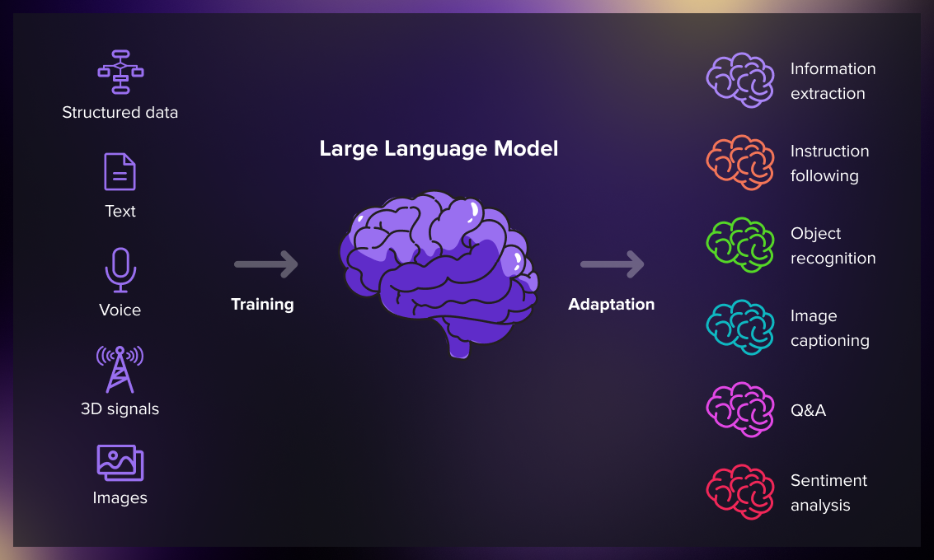
FUNCTIONALITY
PAGE 07
LARGE LANGUAGE MODELS
The main component of Ollama.
Are pre-trained AI models with big amounts of human-like text to learn patterns and regularities, and to understand and generate human language. This models are based on GPT, BERT and ELM transformer architectures.
It’s what’s behind the scenes of all AI chatbots and AI writing generators.

Slide 9
FUNCTIONALITY
OLLAMA MODELS CATEGORIES
MULTIMODAL OR VISION MODELS
Integrate image understanding, analyzing both textual and visual information.
EMBEDDING MODELS
TEXT & CHAT MODELS
Convert text into numerical representations, facilitating tasks like similarity search and information retrieval.
Designed for conversational interactions and text generation.
CODE COMPLETION
Trained on vast amounts of code, generating, completing, and understanding code.
PAGE 07

Slide 10
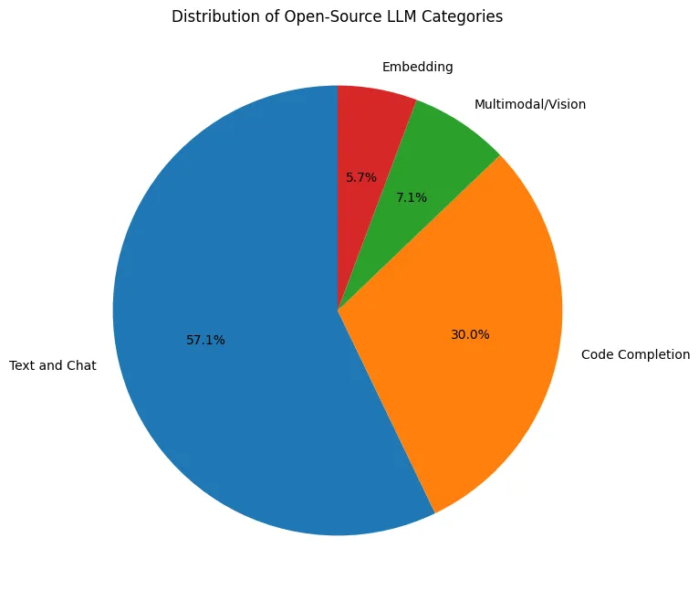
FUNCTIONALITY
DISTRIBUTION OF OPEN-SOURCE LLM CATEGORIES
PAGE 08

Slide 11
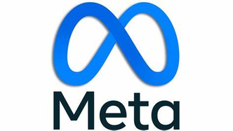



FUNCTIONALITY
PAGE 09
TOP LLM MODELS
PHI3
LLAMA3.2
QWEN2.5
MISTRAL
Parameters: 3B
Size: 2.2GB
Context length: 4K tokens
Parameters: 1B - 3B
Size: 4.7GB
Context length: 131K tokens
Parameters: 0.5B - 72B
Size: 4.7GB
Context length: 128K tokens
Parameters: 7B
Size: 4.1 GB
Context length: 10K tokens
MORE MODELS IN HUGGINGFACE!

Slide 12

CONCLUSIONS
PAGE
PROS
MODEL INFERENCE
Ollama can reduce your model inference time by up to 50%, depending on your hardware configuration.
CUSTOMIZATION
LATENCY
Ollama gives you the freedom to tweak the models as per your needs, something that's often restricted in cloud-based platforms.
Cloud-based models often suffer from network latency. With Ollama, the model runs on your local machine, eliminating this issue.
DATA TRANSFER
With cloud-based solutions, you have to send your data over the internet. Ollama keeps it local, offering a more secure environment for your sensitive data.

Slide 13
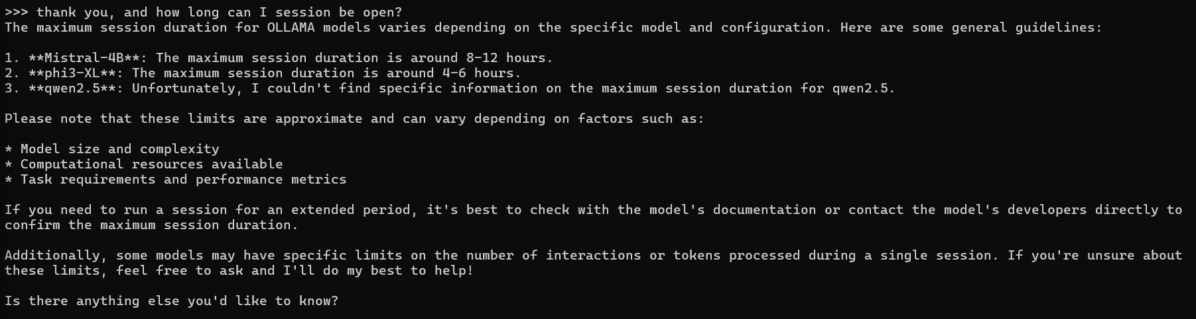
CONCLUSIONS
PAGE
CAUTIONS
CONTEXT-LENGTH AND PARAMETERS LIMITATIONS
OFFLINE ACCESS (A DOUBLE-EDGED SWORD)
SESSION DURATION RESTRICTION
May not have access to real-time data or the ability to learn from new experiences when disconnected from the internet. In certain situations, they might not provide the most accurate or up-to-date information.
TEXT-BASED MODEL
Can’t access to our files stored in our computers because most of them are text-base models. Don’t have that ability to process any file like images or PDFs.

